Slide 1

MEDPATHAI: FROM SYMPTOM TO SOLUTION
AN INTERPRETABLE, MULTIMODAL, AND MULTILINGUAL MEDICAL DIAGNOSTIC AGENT
TEAM : G733
PRESENTED BY : MD AAFTHAB ALI
MENTOR : DR.MANASA

Slide 2
TABLE OF CONTENTS
01
  Introduction
05
  Proposed Solution
02
  Understanding of Base Paper
06
  Architecture
03
  Problem Definition
07
  Conclusion
04
  Scope of Project

Slide 3

INTROUCTION
  Project Title: Chain of Diagnosis (CoD) – An Interpretable Medical Agent for Transparent Disease Diagnosis.
  Base Paper: “CoD: Towards an Interpretable Medical Agent Using Chain of Diagnosis” (Junying Chen et al., 2024).
  Tech Agents: Utilizes Large Language Models (LLMs) and a five-step diagnostic agent system — Symptom Abstraction, Disease Recall, Diagnostic Reasoning, Confidence Assessment, and Decision Making.

Slide 4
UNDERSTANDING BASE PAPER
PROBLEM SOLVED
KEY IDEA
  Lack of Interpretability: Traditional LLMs act like black boxes; CoD makes their reasoning process explainable.
  Unreliable Diagnoses: By using confidence scores and entropy reduction, CoD ensures trustworthy and controlled decisions.
  Limited Data Access: Synthetic patient data generation allows large-scale, privacy-safe medical training.
The base paper introduces the Chain of Diagnosis (CoD) — a transparent diagnostic framework that mirrors how doctors think. It breaks the diagnosis into clear steps, allowing the model to explain why and how each disease is predicted.

Slide 5
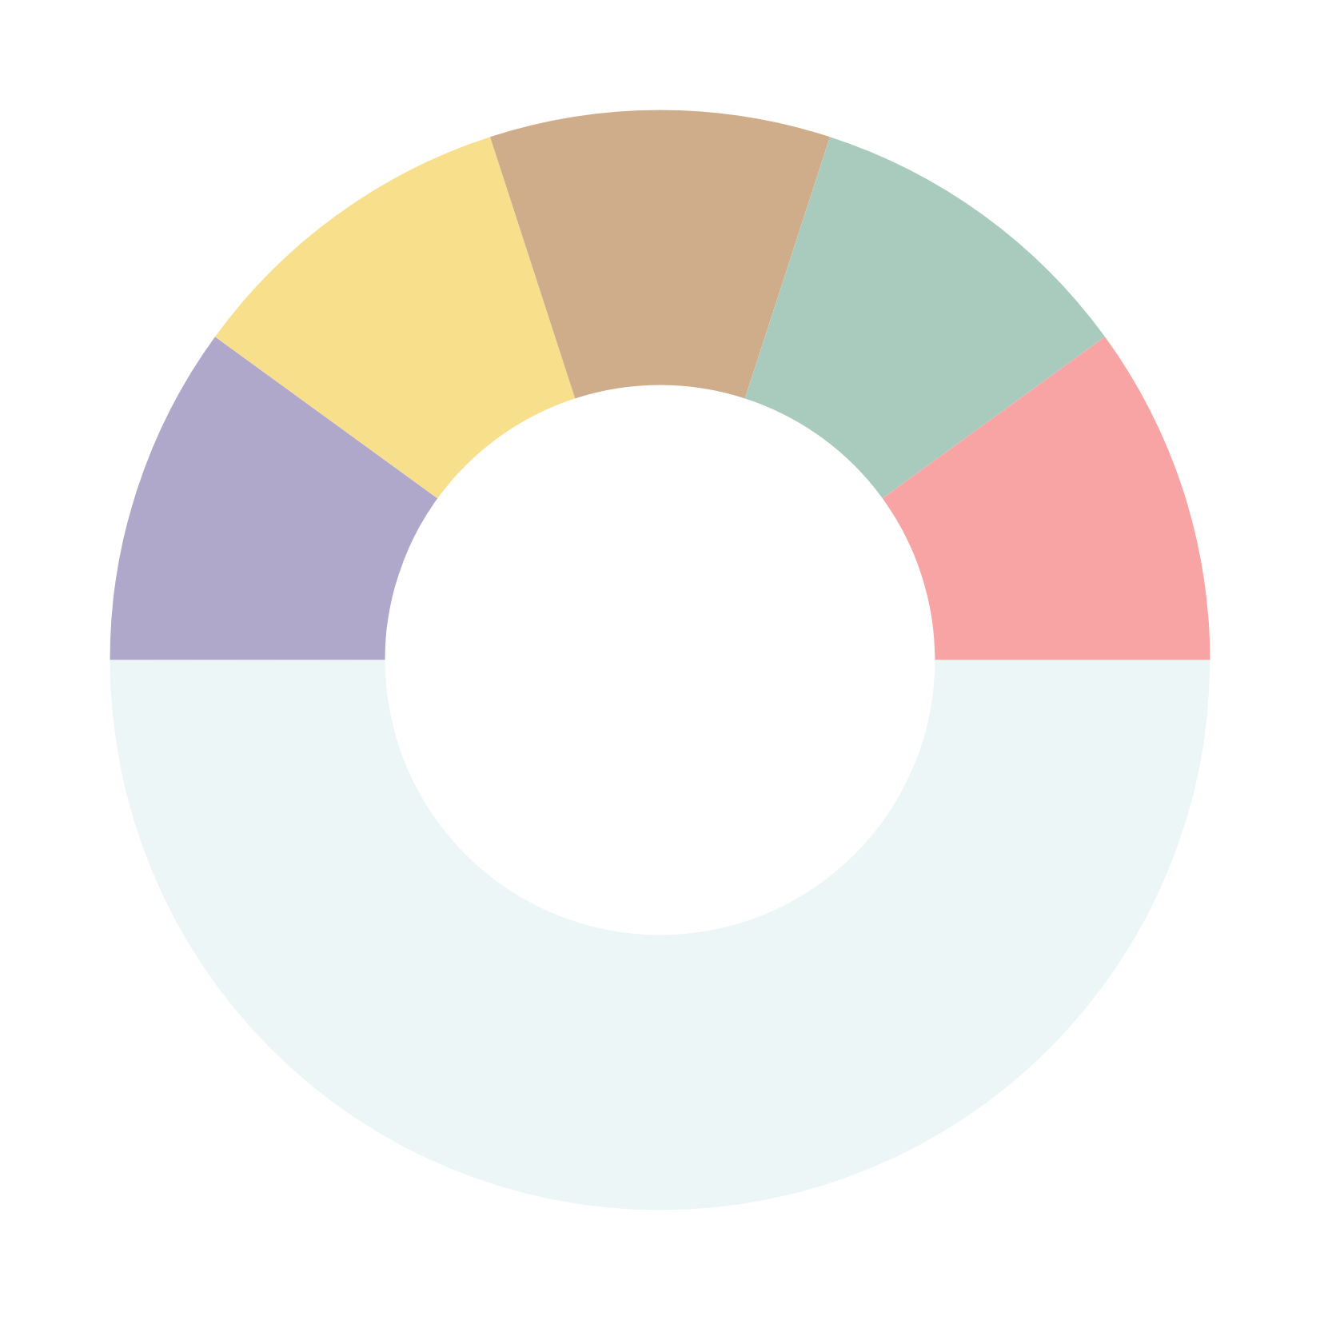

COD FRAMEWOK
3
DIAGNOSTIC
RECOGNITION
4
DISEASE
RECALL
2
CONFIDENCE
ASSESSMENT
5
SYMPTOM
ABSTRACTION
DECISION
MAKING
1

Slide 6
PROBLEM DEFINITION
What Problems Are We Solving?
  Current LLM-based medical systems fail to explain how diagnoses are made. They act as black boxes, offering results without clear reasoning or medical justification.
  Additionally, they cannot adapt or learn interactively from patient responses during the diagnostic process, limiting their effectiveness in real consultations.
Challenges:
  Lack of interpretability and transparency in diagnostic reasoning.
  Risk of hallucinations and unreliable predictions from LLMs.
  Difficulty in balancing accuracy with the number of symptom inquiries.
Why It’s Important:
  Builds trust between clinicians and AI systems.
  Enables explainable and ethical medical decision-making.
  Helps reduce diagnostic errors and uncertainty, improving patient outcomes.

Slide 7

IN SCOPE
OUT SCOPE
  Implementation of the Chain of Diagnosis (CoD) framework for interpretable and transparent disease diagnosis.
  Use of synthetic patient data generated through GPT-4 to ensure data privacy and scalability.
  Integration of a disease knowledge base covering 9,600 diseases for reasoning and retrieval.
  Integration with real-world hospital systems or Electronic Health Records (EHR).
  Regulatory validation such as FDA or HIPAA compliance.
  Deployment for real patient consultations or clinical trials at this stage.
SCOPE

Slide 8
PROPOSED SOLUTION
Core Idea:
  Building upon the base paper Chain of Diagnosis (CoD), we propose an enhanced framework called CoD++, which extends the original model to support multimodal, multilingual, and adaptive reasoning. The aim is to make diagnosis not only interpretable but also inclusive, dynamic, and practically deployable.
Key Enhancements:
  Multilingual Support: Extend CoD to handle multiple languages for diverse global healthcare applications.
  Multimodal Integration: Incorporate medical images, reports, and lab data alongside textual symptoms for richer diagnostic reasoning.
  Interactive Feedback Loop: Enable doctors to refine or correct AI reasoning in real-time, improving model learning and accuracy.

Slide 9
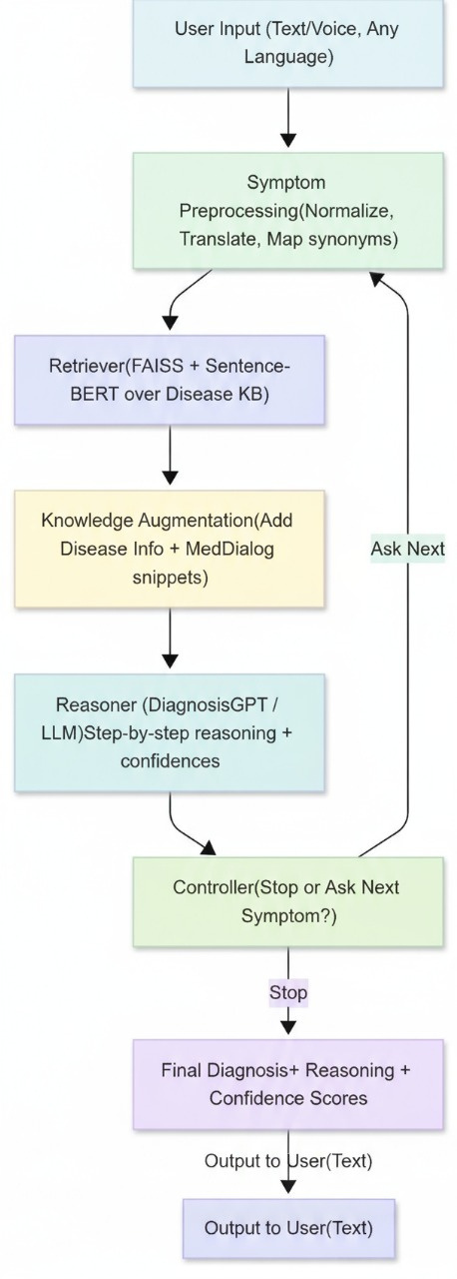
ARCHITECTURE
  User Input: The user provides their symptoms (text or voice).
  Symptom Preprocessing: The system cleans, translates, and standardizes the user's symptom description.
  Retriever: This step searches a medical database (KB) to find diseases that match the user's symptoms.
  Knowledge Augmentation: It gathers extra details about the matched diseases and adds related medical dialogue examples.
  Reasoner: An AI (LLM) analyzes all the information to determine possible diagnoses and how confident it is in each.
  Controller: This decides whether to give an answer now ("Stop") or ask the user for more information ("Ask Next").
  Final Diagnosis: This step packages the final answer, including the reasoning and confidence level.
  Output to User: The final diagnosis is shown to the user as text.

Slide 10
CONCLUSION
The Chain of Diagnosis (CoD) framework represents a major step toward making AI-driven medical diagnosis transparent and interpretable. It mirrors the clinical reasoning process of doctors, allowing AI systems to justify their decisions through logical, step-by-step explanations.
Our extended version, CoD++, advances this concept by introducing multilingual, multimodal, and real-world data integration, enabling the system to handle diverse clinical inputs such as text, reports, and images across multiple languages with interactive feedback
This approach not only improves diagnostic reliability and transparency but also strengthens collaboration between clinicians and AI systems
By the next presentation, we aim to have the full MedPathAI prototype implemented, fine-tuned on the MedDialog dataset, and rigorously evaluated for both low latency and improved diagnostic accuracy.

